Slide 1
Decision Tree
Decision Tree
From NPTEL lecture by Prof. Sudeshana Sarkar

Slide 2
Decision Tree
Tree based Classifier and regression
Decision Node – test done on some feature / attribute →outcomes decides where to go
Leaf Node → classification result (predicted value or probability)

Slide 3
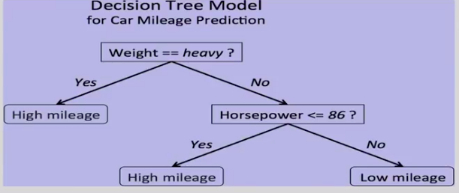

Slide 4
How to learn a decision tree for best data set
Bias
Prefer smaller tree
Low depth
Small no of node
Find smaller tree is a computationally hard problem
So we go for a greedy approach

Slide 5
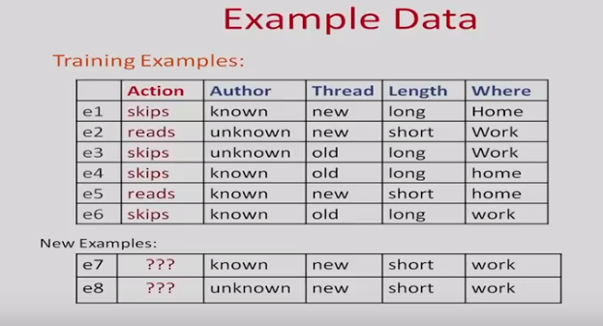

Slide 6
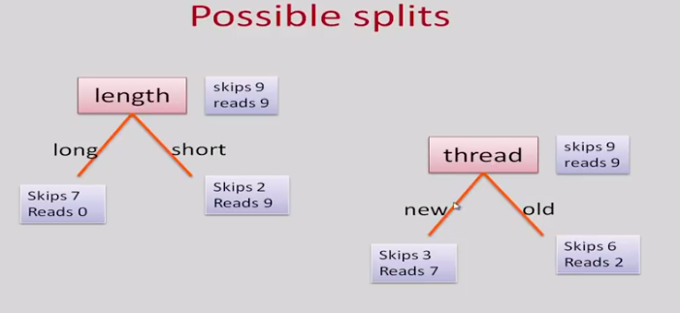
Every node decide whether you want to split on attribute. Decide whether to grow or stop

Slide 7
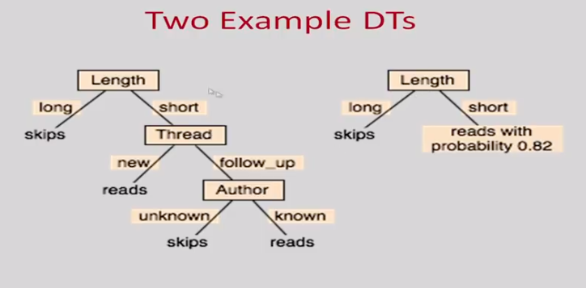

Slide 8
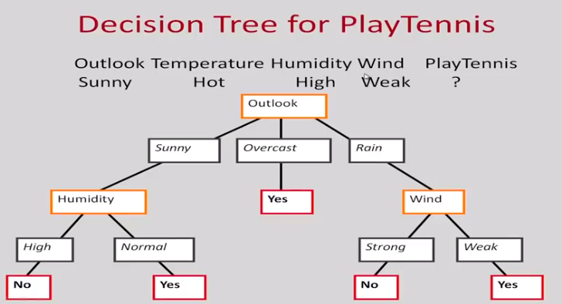

Slide 9
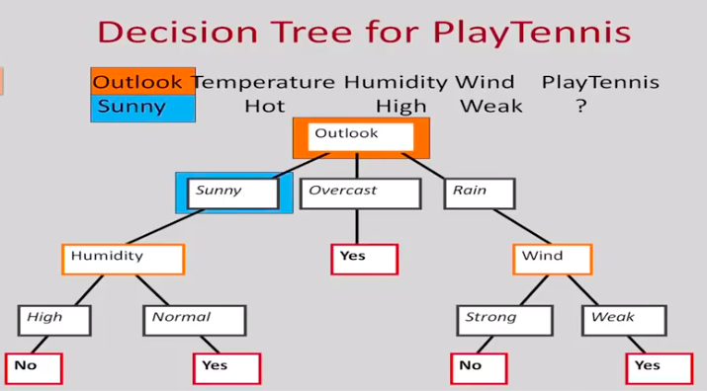
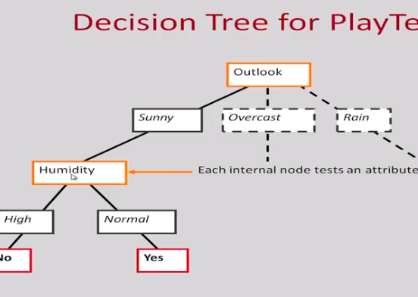

Slide 10
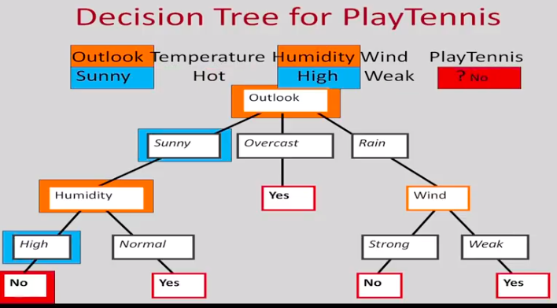


Slide 11
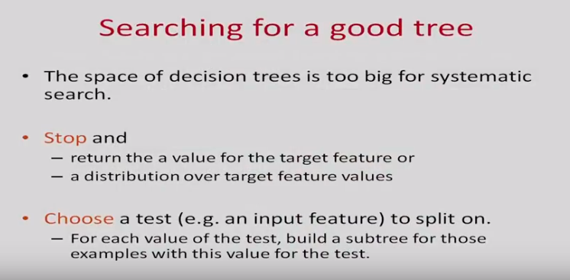

Slide 12
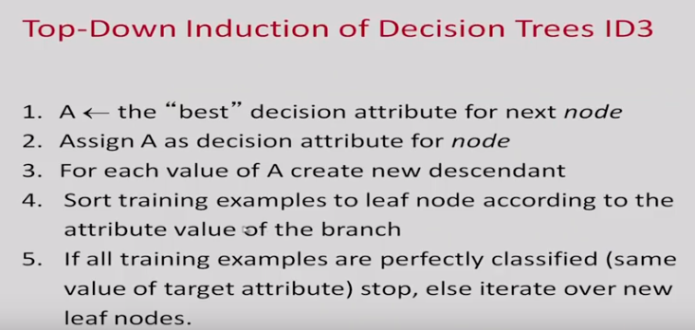

Slide 13
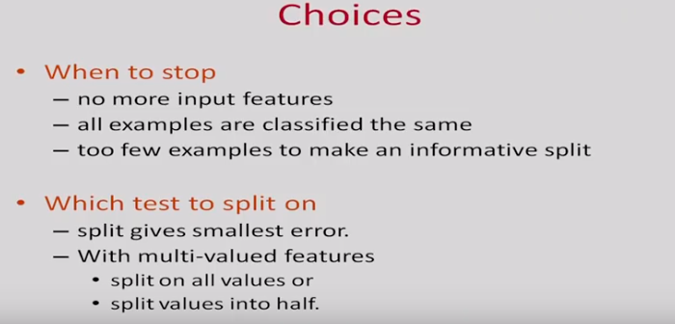

Slide 14
Decisions
Which node to proceed with …
If yes which attribute
When to stop

Slide 15
When to stop
Exahusted all the attributes
If all the values for D1 is classifying as a single class. You can stop
If too few examples in D we can stop

Slide 16
Which attribute to split in
Bias criteria
We prefer simpler functions → ie smaller trees
Heuristics
Which attribute to split on
Stop such as split gives smaller error
Multivalued attribute

Slide 17
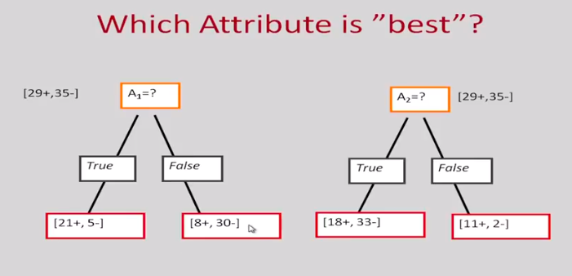

Slide 18
Entropy – measure of disorder in a system
Homogeneous system – if all examples in one class. Entropy 0
Entropy highest – p+ and p- 50%
However in multiple classes – entropy exists
Leaf nodes – entropy is 0
Select node – lowest entropy
Criteria for selecting which attribute
Entropy

Slide 19
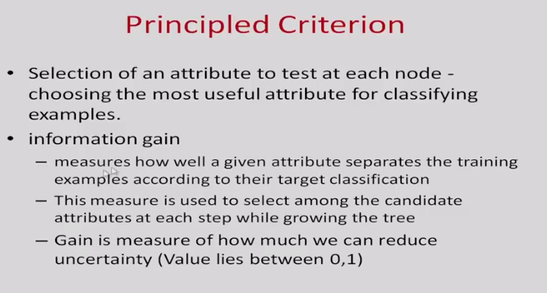

Slide 20
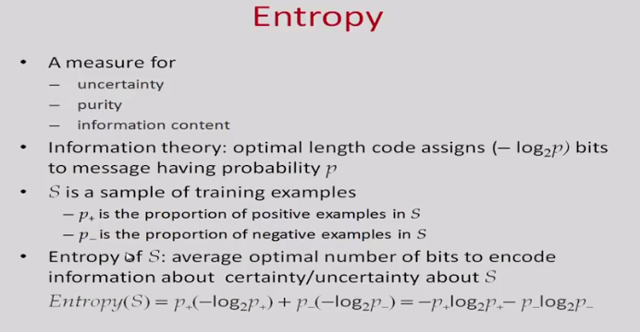

Slide 21
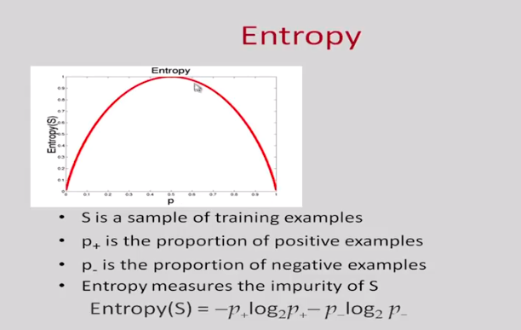
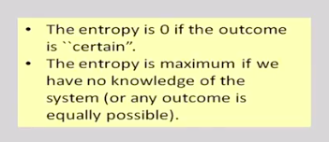

Slide 22
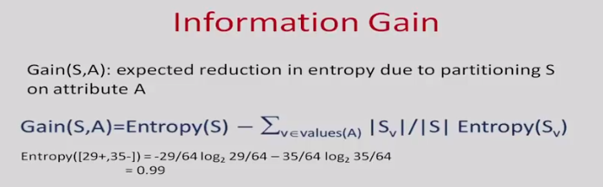

Slide 23
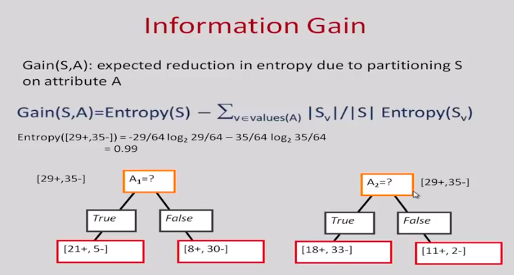

Slide 24
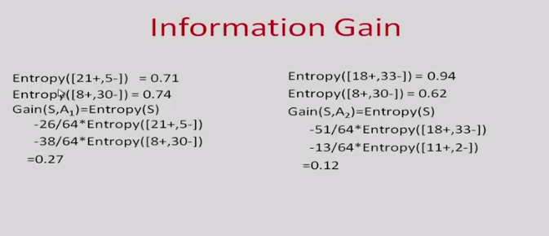

Slide 25
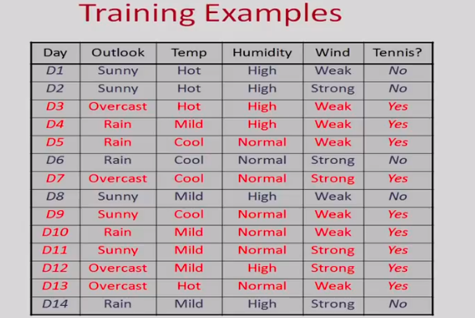

Slide 26
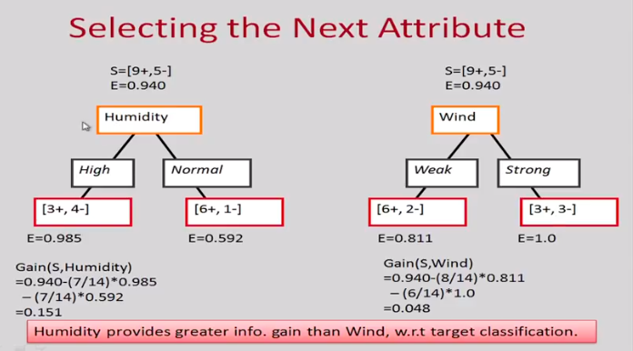

Slide 27
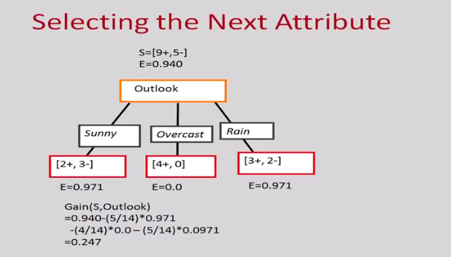

Slide 28
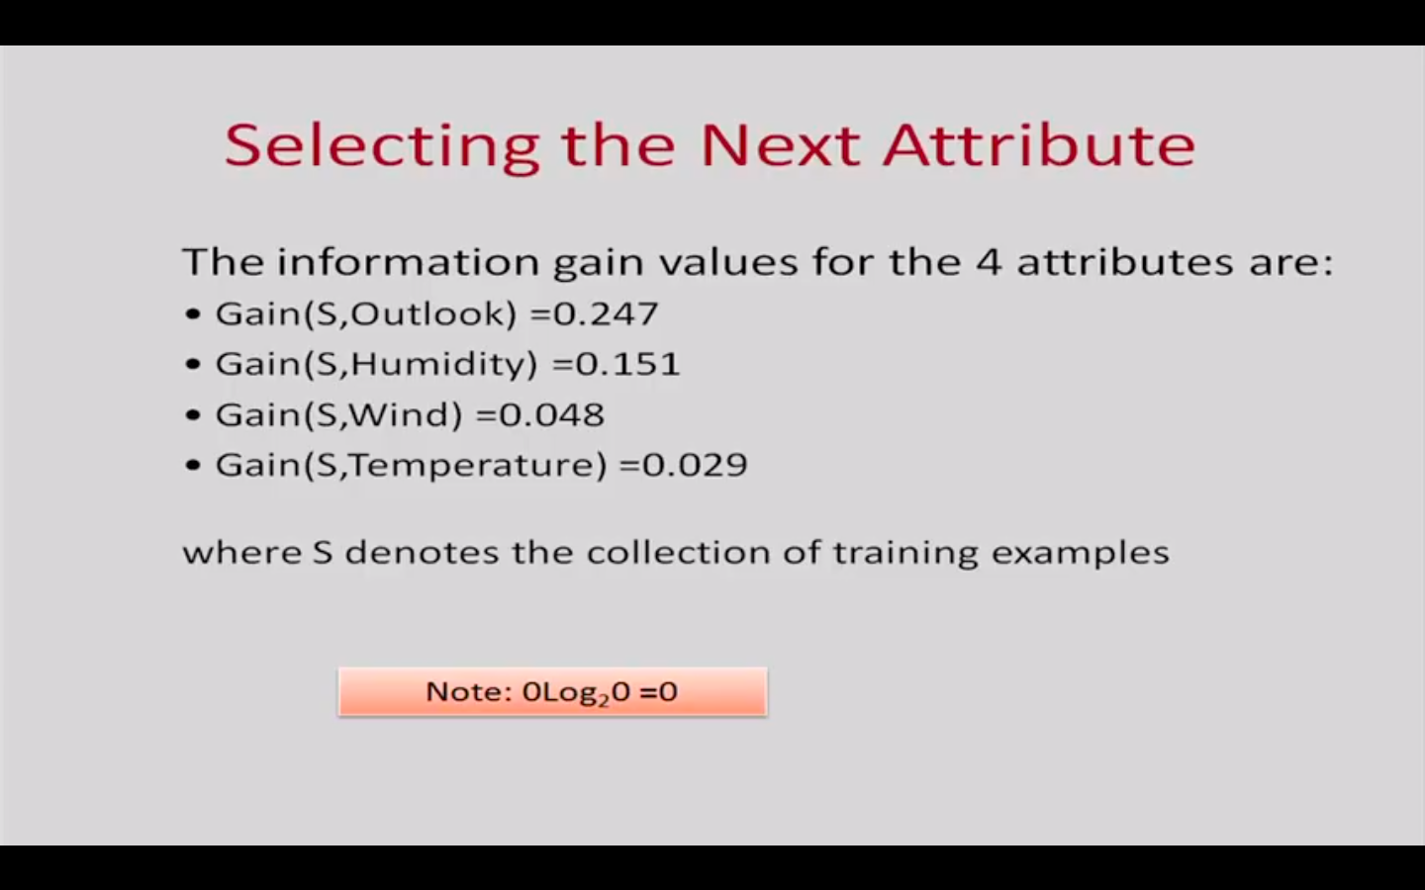

Slide 29
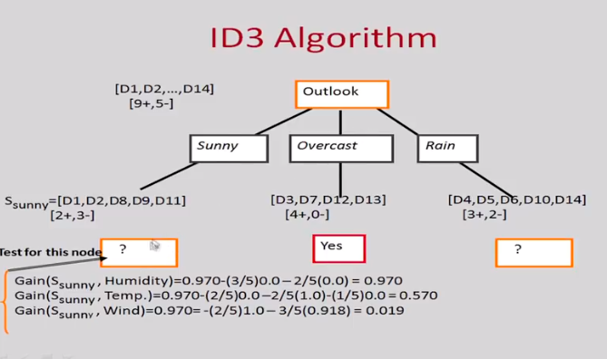

Slide 30
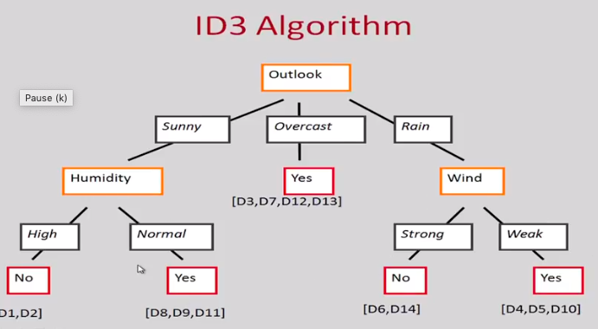

Slide 31
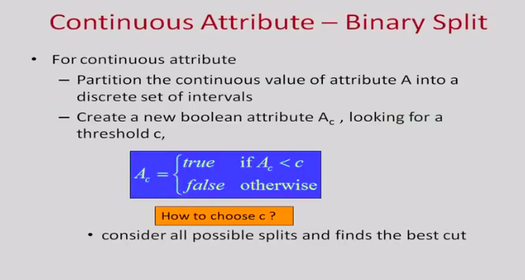

Slide 32
